Slide 1
Perception of Online Advertising - France
Study:
Comparison of 13 different forms of online advertising
Report

Slide 2
Contents
01
04
Methodology - Overview
Level of Disruption – Direct Questions
02
05
Advertising Form under Examination
Level of Disruption – Calculation
03
06
Online behavior
Demography

Slide 3
Methodology - Overview
01
3

Slide 4
Methodology - Overview
Background and Objectives
Method
Target Group
Sample
Eyeo’s aim is to evaluate the perception of 13 different kind of online advertising formats from the internet users point of view.
The survey was carried out as an online ad hoc study based upon a quota sample representing the online population. Interviews were conducted by self-completion questionnaires.
A representative sample based on age, gender and region was drawn from the basic population.
Field time: 13 to 24 November 2015
A total of 2,000 French-speaking residents (aged 16 to 75) of France who are contactable by Internet were interviewed.

Slide 5
Advertising Form under Examination
02
5

Slide 6
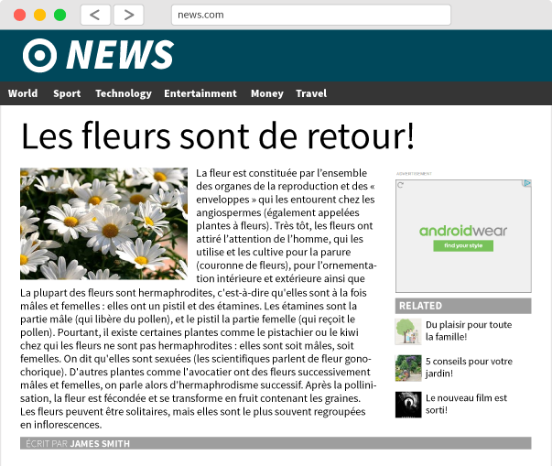
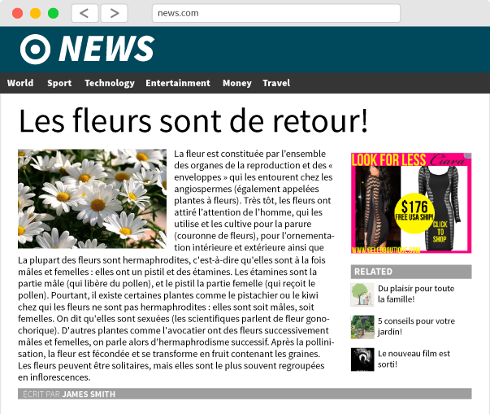
Advertising Forms under Examination: Ad Banner
Ad Banner Conservative
Ad Banner Attention Grabbing
Ad Banner Animated Banner
Ad Banner All Around

Slide 7
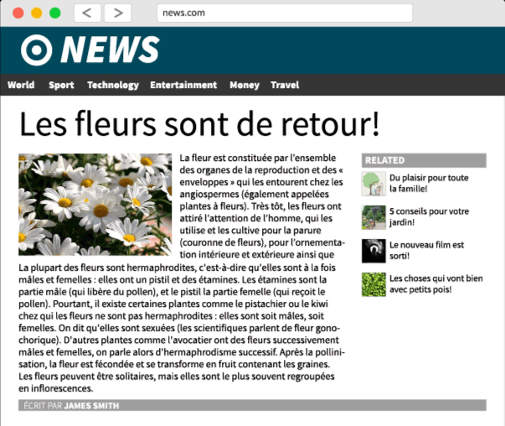
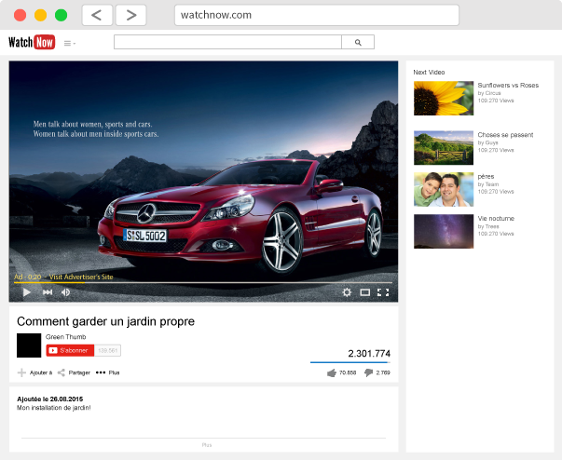
Advertising Forms under Examination: Pop-up and Video Ad
Pop-up
Video Ad Unskippable Video

Slide 8
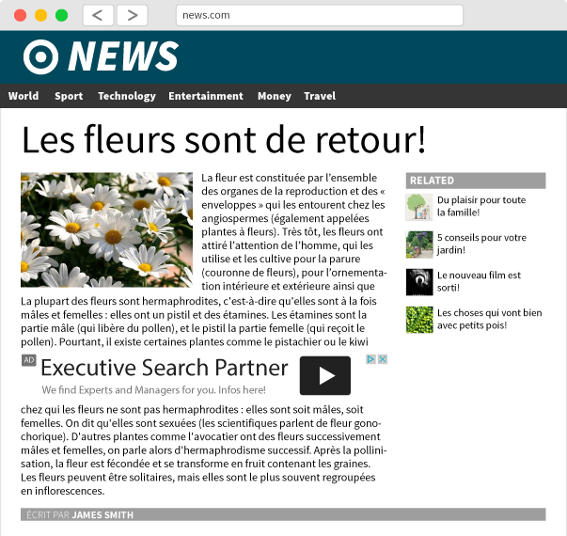
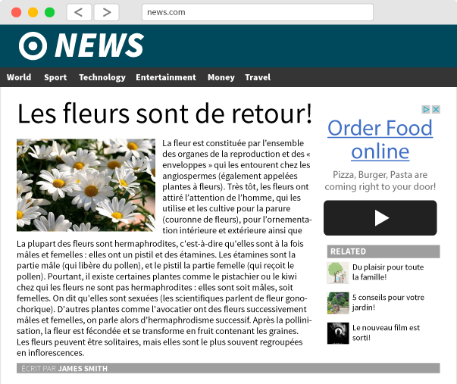
Advertising Forms under Examination: Text Ad
Text Ad - Below
Text Ad - Between
Text Ad - Next To

Slide 9
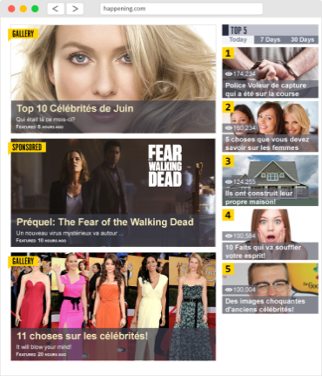
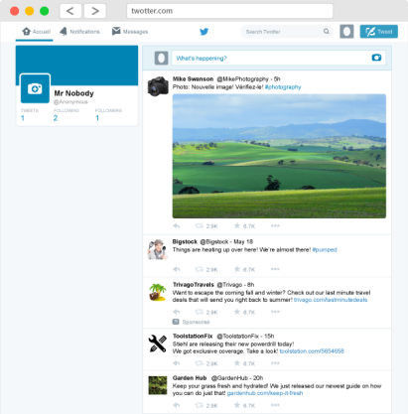
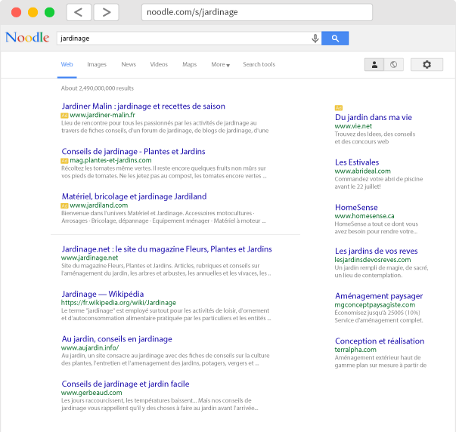
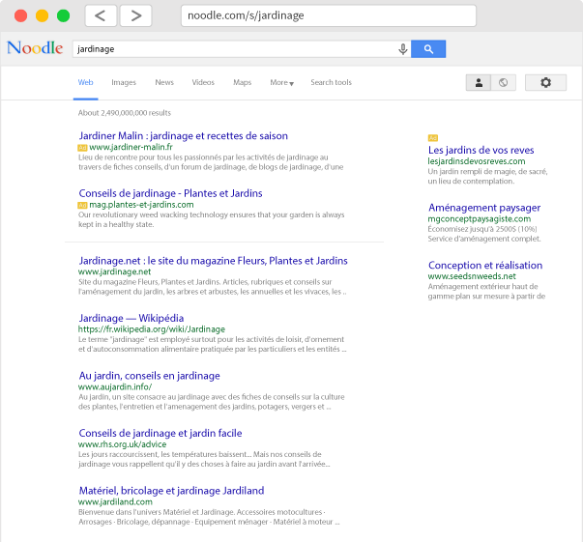
Advertising Forms under Examination:
Native Ad and Search Ad
Native Ad
subtle Native Tweets
Search Ad High Quantity
Search Ad Low Quantity

Slide 10
Online behavior
03
10

Slide 11
Online Usage and Usage of Devices
In France almost all respondents are at least once a in the internet and about more than a third of this all day long. The most used device is a laptop or a smartphone
Online Usage
Usage of Devices
Main Device Used
Laptop
Internet-capable phone or smartphone
Desktop PC (with separate screen)
Tablet
Internet-capable television, receiver or blu-ray player
Game console (e.g. xBox, Playstation)
Hybrid devices such as laptop and tablet in one device
With none of the listed devices
44
13
34
7
2-3 devices on average
Base: All respondents n=2.000, Results in %
Question OA1: How ofen do you go on the Internet?
Question OA2: Some devices that you can use to access the Internet are on the list. Which of these devices do you use to access the Internet - regardless if for work or private purposes? Question OA3: What is the device that you use the most to access the Internet, regardless if for work or private purposes?

Slide 12
Level of Disruption – Direct Questions
04
12

Slide 13
Overall Assessment of Online Advertising
Significantly more than half of the respondents surveyed found this online advertising dispruptive or very disruptive. Only almost one respondent in ten is hardly disturbed
Top-2-Boxes
8.8%
Bottom-2-Boxes
56.4%
Base: All respondents n=2.000, Results in %
Question R1: Please take a moment to think of online advertising and the different types of online advertising that you come across on the Internet. How would you rate online advertising in general in comparison to advertising on television, in the movie theater, and in newspapers?
On this scale 1 means for me online advertising isn't disruptive at all" and 6 means "for me online advertising is very disruptive".

Slide 14
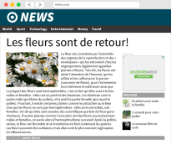
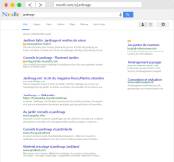
Level of Disruption - Ranking of all Forms - Overview
24.0
36.3
Ad Banner - Conservartive
Text Ad - Between
55.9
19.6
28.2
81.3
Video Ad - Unskippable video
Search Ad - Low Quantity
Text Ad - Below
Pop-up
0
100
isn't' disruptive at all
Search Ad -
High Quantity
subtle Native Tweets
Hidden Native
is very disruptive
31.0
45.1
Ad Banner Animated Banner
20.8
70.2
Ad Banner Attention Grabbing
Ad Banner - All Around
Text Ad - Next To
71.4
28.8
31.3
Base: All respondents n=2.000, Results in %
Question R2: Next you will be shown different pictures of a website. The content of the website is the same in each picture. On each page, however, you will see different types of advertising. For each type of advertising shown, please indicate the level of disruption.
Data: Bottom-2-Boxes

Slide 15
Level of Disruption in Detail Bottom-2-Boxes (1/3)
Most disruptive are Pop-up, Ad Banner (all around/ animated) and Video Ad (unskippable)
Pop-up
Ad Banner - All Around
Ad Banner - Animated Banner
Video Ad - Unskippable video
81.3
71.4
70.2
55.9
0
100
0
100
0
100
0
100
isn't' disruptive at all
is very disruptive
isn't' disruptive at all
is very disruptive
isn't' disruptive at all
is very disruptive
isn't' disruptive at all
is very disruptive
Base: All respondents n=2.000, Results in %
Question R2: Next you will be shown different pictures of a website. The content of the website is the same in each picture. On each page, however, you will see different types of advertising. For each type of advertising shown, please indicate the level of disruption.
Data: Bottom-2-Boxes

Slide 16
Level of Disruption in Detail Bottom-2-Boxes (2/3)
Mean values were reached by native ads, Text Ad (between) and Ad Banner (Attent. Grab.)
Native Ad
Text Ad - Between
Ad Banner –
Attention Grabbing
subtle Native Tweets
45.1
36.3
31.3
31.0
0
100
0
100
0
100
0
100
isn't' disruptive at all
is very disruptive
isn't' disruptive at all
is very disruptive
isn't' disruptive at all
is very disruptive
isn't' disruptive at all
is very disruptive
Base: All respondents n=2.000, Results in %
Question R2: Next you will be shown different pictures of a website. The content of the website is the same in each picture. On each page, however, you will see different types of advertising. For each type of advertising shown, please indicate the level of disruption.
Data: Bottom-2-Boxes

Slide 17
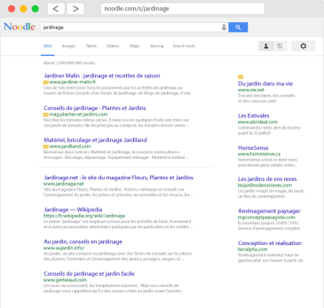
Level of Disruption in Detail Bottom-2-Boxes (3/3)
Comparatively low is the level of disruption for Text Ad, Ad Banner Conservative and Search Ad
Text Ad - Next To
Text Ad - Below
Ad Banner Conservative
Search Ad High Quantity
Search Ad - Low Quantity
28.8
28.2
24.0
20.8
19.6
0
100
0
100
0
100
0
100
0
100
isn't' disruptive at all
is very disruptive
isn't' disruptive at all
is very disruptive
isn't' disruptive at all
is very disruptive
isn't' disruptive at all
is very disruptive
isn't' disruptive at all
is very disruptive
Base: All respondents n=2.000, Results in %
Question R2: Next you will be shown different pictures of a website. The content of the website is the same in each picture. On each page, however, you will see different types of advertising. For each type of advertising shown, please indicate the level of disruption.
Data: Bottom-2-Boxes

Slide 18
Level of Disruption – Bottom-2-Boxes
The bottom-2-box indicates the level of disruption
Pop-up Ad | Ad-Banner - All Around | Ad-Banner - Animated Banner | Video Ad - Unskippable video | Hidden Native Ad | Text Ad - Between | Ad-Banner - Attention Grabbing | subtle Tweets | Text Ad - Next To | Text Ad - Below | Ad-Banner - Conservative | Search Ad - High Quantity | Search Ad - Low Quantity
Base: All respondents n=2.000, Results in %
Question R2: Next you will be shown different pictures of a website. The content of the website is the same in each picture. On each page, however, you will see different types of advertising. For each type of advertising shown, please indicate the level of disruption.
Data: Bottom-2-Boxes

Slide 19
Level of Disruption - Calculation
04
19

Slide 20
Level of Disruption -Calculation
A score per respondent and advertising forms was calculated
The calculation is based on different scaled questions as follows:
Question R1: Overall assessment of online advertising
Question R2: Level of disturbance (All advertising forms successively)
Question R3: Ranking of the advertising forms (Comparatively testing of the advertising forms)
Question R4: Level of Disturbance (Test of selected advertising forms depending on response behavior in question R3)
The score indicates the level of disruption. Possible is a value area from 0 (=isn't‘ disruptive at all) to 100 (=very disruptive).
0
100
isn't' disruptive at all
is very disruptive

Slide 21
Level of Disruption - Ranking of all Forms - Overview
19.1
32.3
Ad Banner - Conservartive
42.8
13.9
21.6
63.6
Text Ad - Between
Video Ad - Unskippable video
Search Ad - Low Quantity
Text Ad - Below
Pop-up
0
100
isn't' disruptive at all
Search Ad -
High Quantity
Ad Banner Attention Grabbing
Hidden Native
is very disruptive
37.3
Ad Banner Animated Banner
17.2
26.6
51.1
Ad Banner - All Around
Text Ad - Next To
subtle Native Tweets
58.3
19.2
28.5
Base: All respondents n=2.000, Results in %
Question R1: Overall Assessment of Online Advertising; Question R2: Level of Disturbance (All Advertising Forms)
Question R3: Ranking of the Advertising Forms; Question R4: Level of Disturbance (Selected Advertising Forms)
Scores: Average of the individual scores per advertising form calculated from Questions R01 to R04, value area from 0 (irrelevant) to 100 (=very disruptive) possible

Slide 22
Level of Disruption in Detail (1/3)
Most disruptive are Pop-up, Ad Banner (all around/ animated) and Video Ad (unskippable)
Pop-up
Ad Banner - All Around
Ad Banner - Animated Banner
Video Ad - Unskippable video
63.6
58.3
51.1
42.8
0
100
0
100
0
100
0
100
isn't' disruptive at all
is very disruptive
isn't' disruptive at all
is very disruptive
isn't' disruptive at all
is very disruptive
isn't' disruptive at all
is very disruptive
Base: All respondents n=2.000, Results in %
Question R1: Overall Assessment of Online Advertising; Question R2: Level of Disturbance (All Advertising Forms)
Question R3: Ranking of the Advertising Forms; Question R4: Level of Disturbance (Selected Advertising Forms)
Scores: Average of the individual scores per advertising form calculated from Questions R01 to R04, value area from 0 (irrelevant) to 100 (=very disruptive) possible

Slide 23
Level of Disruption in Detail (2/3)
Mean values were reached by native ads, Text Ad (between) and Ad Banner (Attent. Grab.)
Native Ad
Text Ad - Between
subtle Native Tweets
Ad Banner –
Attention Grabbing
37.3
32.3
28.5
26.6
0
100
0
100
0
100
0
100
isn't' disruptive at all
is very disruptive
isn't' disruptive at all
is very disruptive
isn't' disruptive at all
is very disruptive
isn't' disruptive at all
is very disruptive
Base: All respondents n=2.000, Results in %
Question R1: Overall Assessment of Online Advertising; Question R2: Level of Disturbance (All Advertising Forms)
Question R3: Ranking of the Advertising Forms; Question R4: Level of Disturbance (Selected Advertising Forms)
Scores: Average of the individual scores per advertising form calculated from Questions R01 to R04, value area from 0 (irrelevant) to 100 (=very disruptive) possible

Slide 24
Level of Disruption in Detail (3/3)
Comparatively low is the level of disruption for Text Ad, Ad Banner Conservative and Search Ad
Text Ad - Below
Text Ad - Next To
Ad Banner Conservative
Search Ad High Quantity
Search Ad - Low Quantity
21.6
19.2
19.1
17.2
13.9
0
100
0
100
0
100
0
100
0
100
isn't' disruptive at all
is very disruptive
isn't' disruptive at all
is very disruptive
isn't' disruptive at all
is very disruptive
isn't' disruptive at all
is very disruptive
isn't' disruptive at all
is very disruptive
Base: All respondents n=2.000, Results in %
Question R1: Overall Assessment of Online Advertising; Question R2: Level of Disturbance (All Advertising Forms)
Question R3: Ranking of the Advertising Forms; Question R4: Level of Disturbance (Selected Advertising Forms)
Scores: Average of the individual scores per advertising form calculated from Questions R01 to R04, value area from 0 (irrelevant) to 100 (=very disruptive) possible

Slide 25
Level of Disruption – Average Values of the Score
The score indicates the level of disruption
Pop-up | Ad-Banner - All Around | Ad-Banner - Animated Banner | Video Ad - Unskippable video | Hidden Native Ad | Text Ad - Between | subtle Native Tweets | Ad-Banner - Attention Grabbing | Text Ad - Below | Text Ad - Next To | Ad-Banner - Conservative | Search Ad - High Quantity | Search Ad - Low Quantity
Base: All respondents n=2.000, Results in %
Question R1: Overall Assessment of Online Advertising; Question R2: Level of Disturbance (All Advertising Forms)
Question R3: Ranking of the Advertising Forms; Question R4: Level of Disturbance (Selected Advertising Forms)
Scores: Average of the individual scores per advertising form calculated from Questions R01 to R04, value area from 0 (irrelevant) to 100 (=very disruptive) possible

Slide 26
Level of Disruption – Median of the Score
The score indicates the level of disruption
Pop-up | Ad-Banner - All Around | Ad-Banner - Animated Banner | Video Ad - Unskippable video | Hidden Native Ad | Text Ad - Between | subtle Native Tweets | Ad-Banner - Attention Grabbing | Text Ad - Below | Ad-Banner - Conservative | Text Ad - Next To | Search Ad - High Quantity | Search Ad - Low Quantity
Base: All respondents n=2.000, Results in %
Question R1: Overall Assessment of Online Advertising; Question R2: Level of Disturbance (All Advertising Forms)
Question R3: Ranking of the Advertising Forms; Question R4: Level of Disturbance (Selected Advertising Forms)
Scores: Average of the individual scores per advertising form calculated from Questions R01 to R04, value area from 0 (irrelevant) to 100 (=very disruptive) possible

Slide 27
Top Ad
Top-Ad: Percentage share of advertising forms that disrupt most in the individual case
Pop-up Ad | Ad-Banner - All Around | Ad-Banner - Animated Banner | Video Ad - Unskippable video | Hidden Native Ad | subtle Tweets | Search Ad - High Quantity | Text Ad - Between | Text Ad - Next To | Search Ad - Low Quantity | Ad-Banner - Attention Grabbing | Text Ad - Below | Ad-Banner - Conservative
Base: All respondents n=2.000, Results in %
Question R1: Overall Assessment of Online Advertising; Question R2: Level of Disturbance (All Advertising Forms)
Question R3: Ranking of the Advertising Forms; Question R4: Level of Disturbance (Selected Advertising Forms)
Scores: Average of the individual scores per advertising form calculated from Questions R01 to R04, value area from 0 (irrelevant) to 100 (=very disruptive) possible

Slide 28
Very disruptive
disruptive impact: Frequency of each of advertising form with a score greater than 90 in the individual case
Pop-up Ad | Ad-Banner - All Around | Ad-Banner - Animated Banner | Video Ad - Unskippable video | Hidden Native Ad | subtle Tweets | Text Ad - Between | Ad-Banner - Attention Grabbing | Text Ad - Next To | Text Ad - Below | Search Ad - High Quantity | Ad-Banner - Conservative | Search Ad - Low Quantity
Base: All respondents n=2.000, Results in %
Question R1: Overall Assessment of Online Advertising; Question R2: Level of Disturbance (All Advertising Forms)
Question R3: Ranking of the Advertising Forms; Question R4: Level of Disturbance (Selected Advertising Forms)
Scores: Average of the individual scores per advertising form calculated from Questions R01 to R04, value area from 0 (irrelevant) to 100 (=very disruptive) possible

Slide 29
Not disruptive at all
Irrelevant: Frequency of each of advertising form with a score less than 5 in the individual case
Search Ad - Low Quantity | Search Ad - High Quantity | Text Ad - Next To | Ad-Banner - Conservative | Text Ad - Below | Ad-Banner - Attention Grabbing | subtle Tweets | Text Ad - Between | Hidden Native Ad | Video Ad - Unskippable video | Ad-Banner - Animated Banner | Pop-up Ad | Ad-Banner - All Around
Base: All respondents n=2.000, Results in %
Question R1: Overall Assessment of Online Advertising; Question R2: Level of Disturbance (All Advertising Forms)
Question R3: Ranking of the Advertising Forms; Question R4: Level of Disturbance (Selected Advertising Forms)
Scores: Average of the individual scores per advertising form calculated from Questions R01 to R04, value area from 0 (irrelevant) to 100 (=very disruptive) possible

Slide 30
Demography
06
30

Slide 31
Demography
Values in percent
Life stages
(D1)
Total
Monthly Net Household Income (D3)
Total
Gender (S1)
Total
Male | 51
Female | 49
Living alone/ own household | 18
Living with partner/ one household | 32
Living with family (partner and child/children) | 35
Living with child/ children (single parent) | 6
Sharing a household with friends/ roommates | 1
Living with parents/ not have own household | 9
bis zu € 499 | 2
€ 500-999 | 4
€ 1.000-1.499 | 10
€ 1.500-1.999 | 14
€ 2.000-2.499 | 6
€ 2.500-2.999 | 13
€ 3.000-3.499 | 13
€ 3.500 + | 20
No answer | 13
Age (S2)
Total
16-34 years | 32
35-54 years | 37
55 and older | 31
Educational Level
(D2)
Total
Online Usage (OA1)
Total
Elementary school and below | 5
High school diploma or GED | 16
High school diploma with SAT/ACT score | 27
University degree (bachelor, master, PhD) | 52
All day | 38
Several times/ half a day | 52
Once a day | 8
Less | 3

